Slide 1
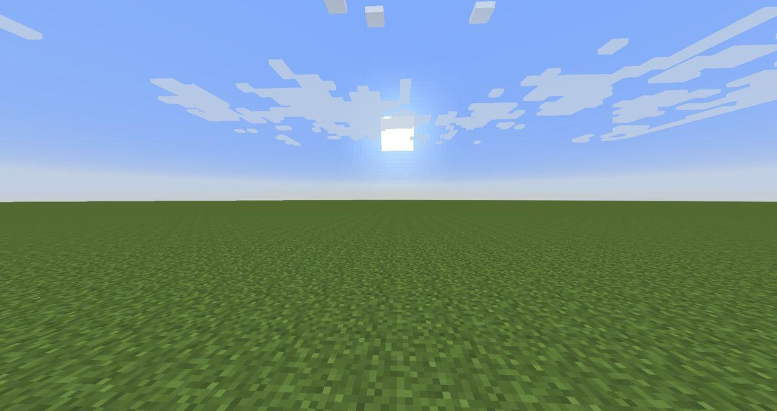



Team
Team Name - StarWeb
Members’ Name - Kanishka Pandey & Dhruv Makkar
Role - Kanishka - AI & Backend Lead, Dhruv - UI & UX lead

Slide 2


Problem Statement & Theme
THE PROBLEM
IMPACT
If 1% of 115M women avoid one bad trade/year → $483 crore of recovered income for the most underserved farmers of India.
83% of eligible women have never claimed a government scheme, Sakhi Al bridges that gap automatically.
Language Exclusion & The Literacy Gap: Over 200 agriculture apps exist in India, but they are all useless to the 115 million women who do most of the farm work because these apps require users to read and type in English or Hindi script.
Price Exploitation: Outside traders take advantage of this information gap, cheating farmers on crop prices because they have no quick way to verify real market rates.
Network Dead Zones: Rural internet is highly unreliable, causing standard cloud-based apps to fail exactly when farmers need them most.
Field Safety Risks: 1 in 3 women farmers report feeling unsafe or vulnerable when working alone in remote fields.
AI/ML TRACK ALIGNMENT
NLP
Whisper Speech recognises 7 Indian languages
Generative AI
Gemini API answers grounded in ICAR documents
Predictive Analysis
7 days Mandi price trend + crop disease risk
115 M
Women farm workers
Rs. 42K
Avg loss per trade
83 %
Schemes never claimed
0
Voice first tools
Computer Vision
Leaf photo —> disease diagnosis via vision model
Automation
Offline queue, auto sync, SOS alert

Slide 3
Solution
SOLUTION OVERVIEW
Sakhi Al is a voice-first, RAG-powered Al assistant that lets non-literate rural women farmers ask agricultural questions in their own language and get verified, spoken answers - with or without internet.
1. She Speaks
Taps one button, asks in her regional language. No typing required.
2. AI Transcribes
Whisper converts voice to text at 95% accuracy across 7 Indian languages in <3 secs(with internet).
3. RAG searches
LangChain classifies intent.
ChromaDB searches 10,000+ ICAR
docs + fetches live mandi & weather data.
4. Gemini Answers
Gemini API generates a low complexity answer with source citation. TTS reads it back in her dialect.
KEY FEATURES
UNIQUE VALUE
Mandi price engine : Live AgMarket prices, to let her know prices before any negotiation
Scheme Finder : All PM-KISAN / PMFBY schemes, offline, in her language
Price Trend Prediction : 7-day rolling average, tells her when to sell
Crop Disease Diagnosis : Voice or photo —> ICAR matched disease + remedy
One Tap SOS Safety : Gps location via SMS/ WhatsApp
Crop Risks Alerts : Weather + ICAR maps —> early disease warning
Voice-first by design: Not a chatbot. Not a form. One tap → speak → answer.
Zero typing at any step.
Works without internet: Hive DB local cache. Questions queued offline, answered when online. No other agri-Al does this.
Women-first prompting: Gemini is instructed with women first context, low complexity answers with local dialect alignment, ensuring responses are highly accessible and easily understandable .

Slide 4










Architecture
TECH STACK
DATA FLOW DIAGRAM
Online
Flutter App - farmer input
Offline/SOS
Fast API Backend
Offline?
Hive DB
Local cache
Faster Whisper - NLP / Speech to text
Queue
Syncs when online
LangChain - intent classifier
Classifies intent-> price/ crop disease/ scheme/ weather/ SOS
SOS?
Cached answer
APIs USED
Chroma DB- Vector search
Finds top 3 ICAR documents chunks
Live data APIs
AgMarkNet , OpenWeather
Gemini Vision . CV
Leaf photo input -> disease identified
SOS path
WhatsApp cloud and Twilio APIs
Faster Whisper - voice to text(7 Indian languages)
Supabase REST - conversation logs + users
Gemini API . Generative AI . Predictive Analysis
Questions + ICAR chunks + live data + CV results -> plain language answers. Source citation. Price trend prediction
Gemini API (google) - answer generation + computer vision
Feedback rating
Thumbs up/ down -> Supabase
GPS sent
3 contacts notified
Google cloud TTS API
Text to speech
Fast API -> flutter response
Twilio & WhatsApp cloud APIs - SMS SOS + WhatsApp alert
Save rating
Supabase
Logs + feedback
Farmer hears answer
In her language . <30secs
Model improves
Wrong answers flagged
Open Weather API - Hyperlocal weather data
AgMarkNet API - live Mandi prices
Google cloud TTS API - spoken voice synthesis adjusted to regional dialects
Log chat session

Slide 5
Market Research & Analysis
TARGET USERS
MARKET SIZE
Primary
Non-text-literate women farmers in Maharashtra, Andhra Pradesh, Telangana, Uttar Pradesh, Bihar (states with highest female agri workforce).
TAM
SAM
SOM
Rs.2 Lakh Cr.
Total Addressable Market
Indian AgriTech by 2030
(10x from Rs. 2 Lakh Cr in 2024)
115 M women farmers
40 M
Serviceable Addressable
Women farmers in Hindi, Marathi and Telugu states with smartphone access
500 K
Obtainable Year 1
Via NGOs partnerships, state agri-dept tie ups in Maharashtra and AP
Secondary
Krishi Mitra extension workers & agricultural NGOs using Sakhi AI as a last mile community advisory tool for their communities.
Tertiary
Government bodies (NABARD, Ministry of Agriculture) automating digitized scheme distribution and direct-to-farmer welfare validation.
POTENTIAL REVENUE MODEL
EXPECTED GROWTH
B2G
License to state agri dept at RS 5-15/user/month.
Rs. 2.5-7.5Cr/month at 500K users
B2B NGO
White label SaaS for micro-finance institutions & agri NGOs serving rural women borrowers
B2B Input
earning commissions through sales & advertisements of
unrelated products
YEAR 1
3 languages (Hindi, Marathi, Telugu), 2 states (Maharashtra, AP), 500K users via NGO partnerships. Focus: product-market fit and corpus quality.
YEAR 2
7 languages, 8 states, 5M users. Government of India PMKSY (Per Drop More Crop) integration. First B2G revenue contracts.
YEAR 3
Expand to Bangladesh, Nepal, sub-Saharan Africa (same voice-first RAG architecture, different language corpus). 20M+ users globally.

Slide 6
Future Scope
MOBILE APP DEVELOPMENT
AI MODEL IMPROVEMENT
PHASE 1
Android First App:
Flutter optimised for low-end Android (2GB RAM, Android 8+) . Built for 2G , 3G speeds with aggressive local caching.
PHASE 2
WhatsApp Bot:
Voice note to WhatsApp reply. 500M+ Indian users. Zero app download needed ( lowest barrier to entry possible )
PHASE 3
IVRS (zero smartphone) :
Dial a number, ask your question, get a spoken answer. Works on any basic phone (no smartphone required at all).
Dialect Fine Tuning
Fine tuning whisper on actual rural dialect audio
(Push accuracy from 95% to 99 % for local accents and regional variations)
Personalised profiles
after a few months of usage, the system remembers her specific farm details, delivering instant, tailored advice without making her re-explain her context every time.
Yield Prediction Model
Historical Mandi data + weather + NASA MODIS satellite imagery to predict optimal harvest timing per crop per district.
ENTERPRISE INTEGRATION
SCALING TO GLOBAL USERS
eNAM
Direct APIs with National Agricultural Market, real time prices from 1000+ Mandis across India.
The architecture is replicable : swap ICAR docs with CGIAR docs, Hindi for Swahili (same system can serve Kenya, Ethiopia, Bangladesh)
PMFBY
Integrates with crop insurance so Sakhi AI initiates claims directly after a disease/ weather event.
UN SDG alignment :
SDG 1 - No poverty | SDG 2 - Zero hunger | SDG 5 - Gender equality
Input Chain
Connect seeds and fertilisers distributors, advise what to use and where to buy.
Advisory to purchase loop.

Slide 7
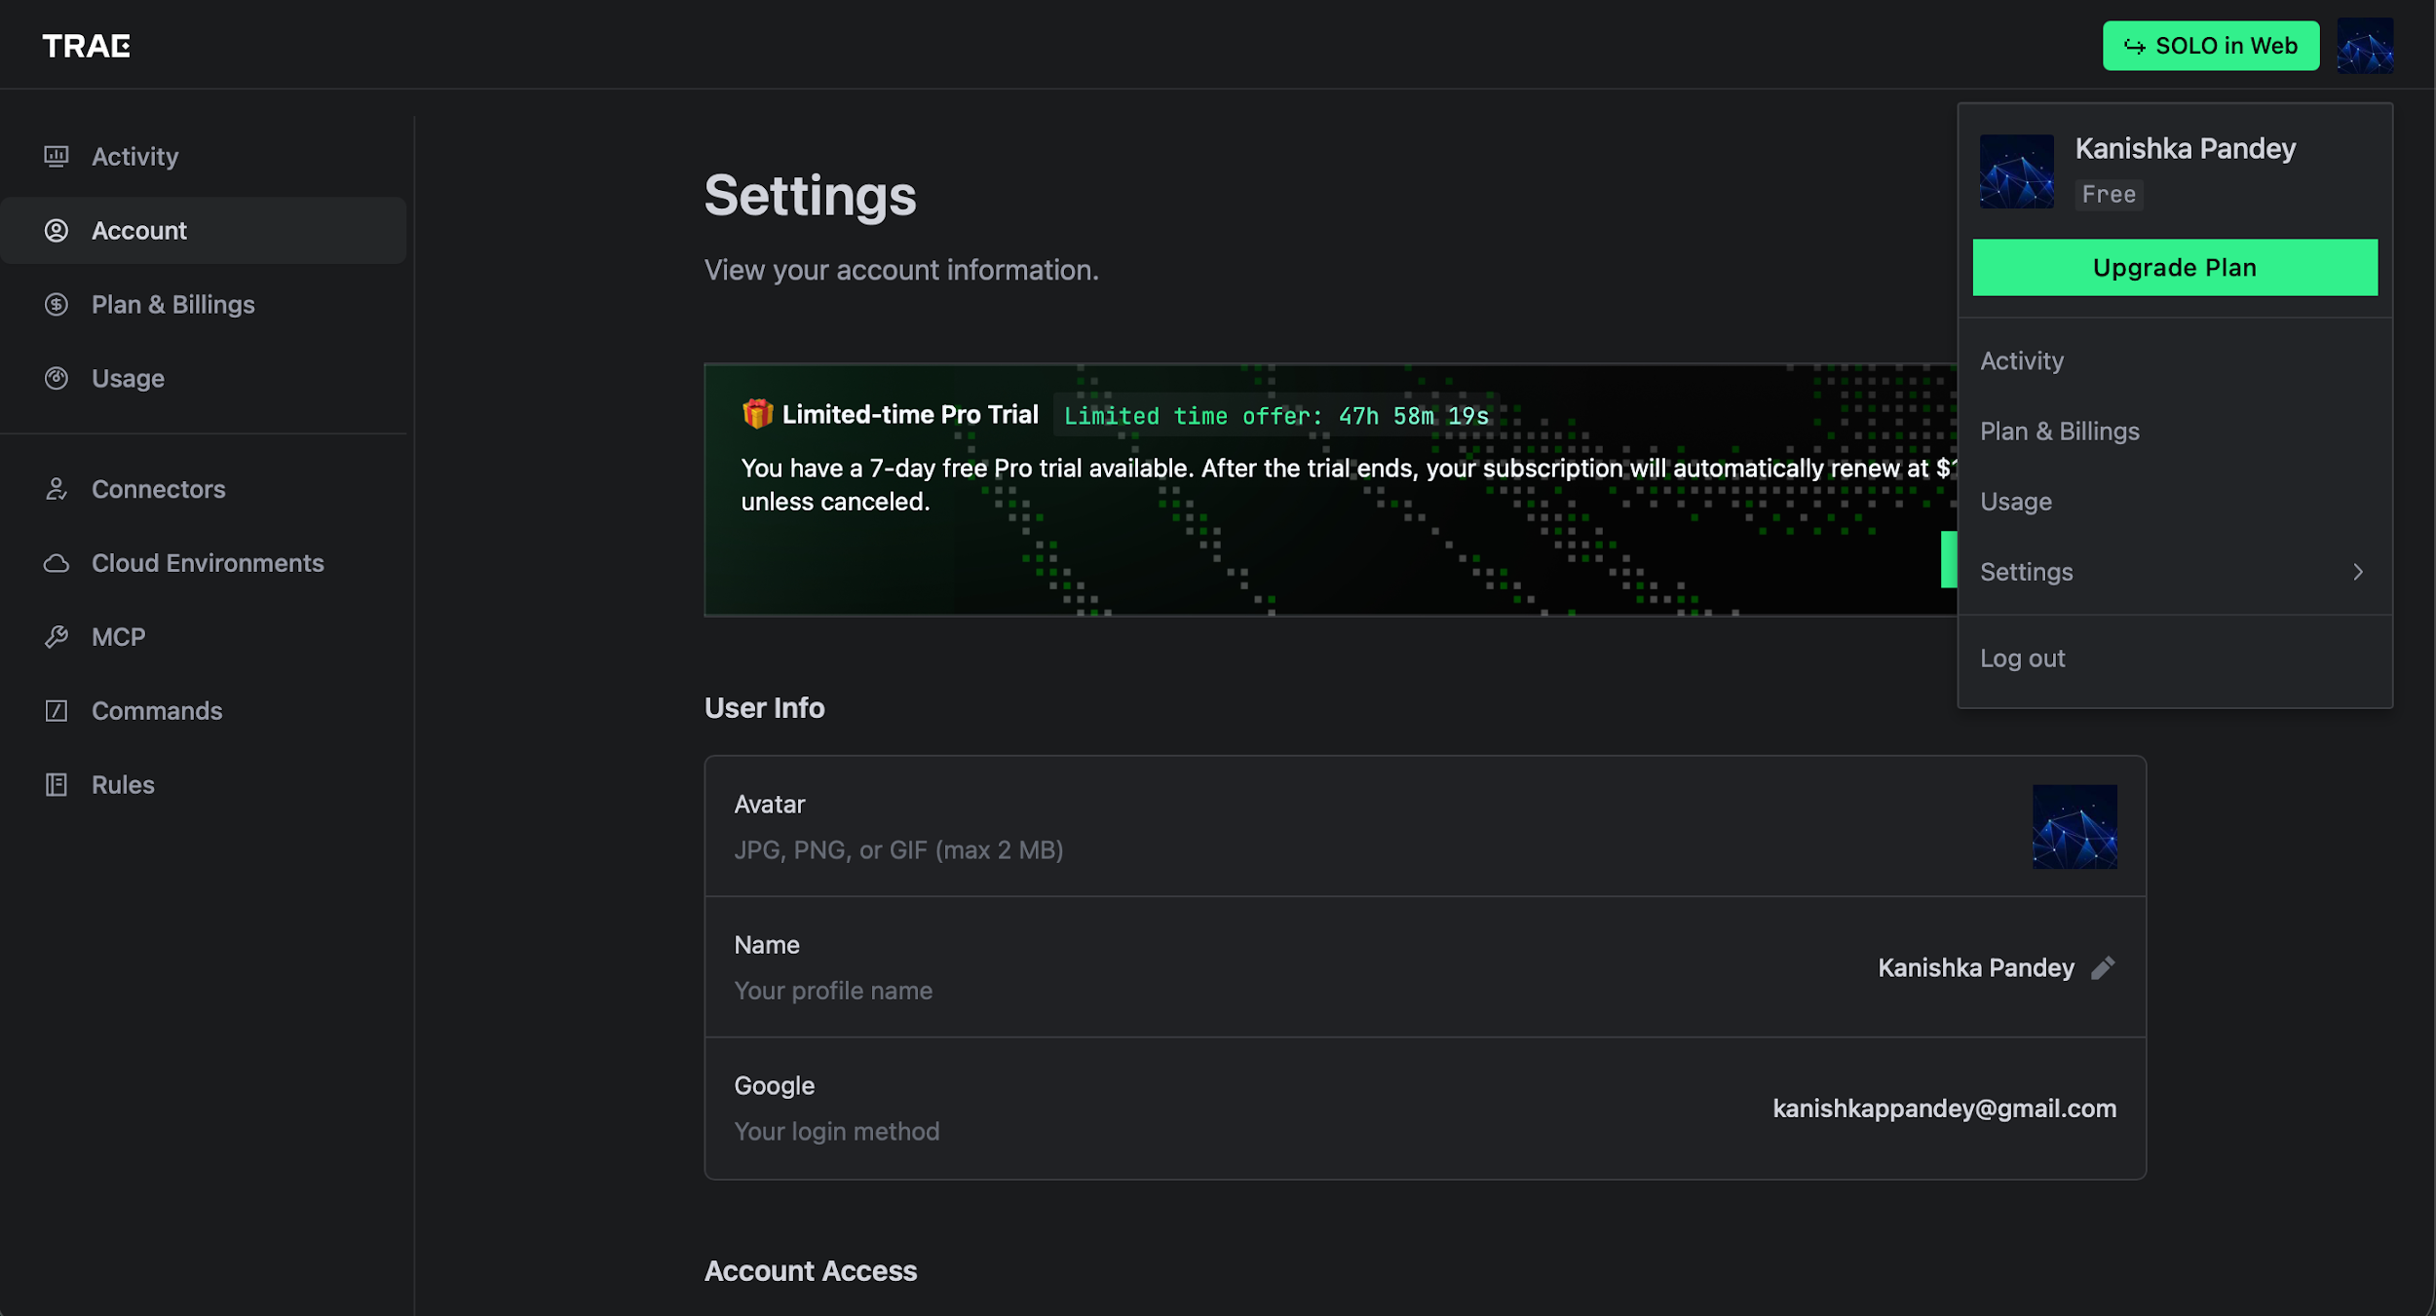
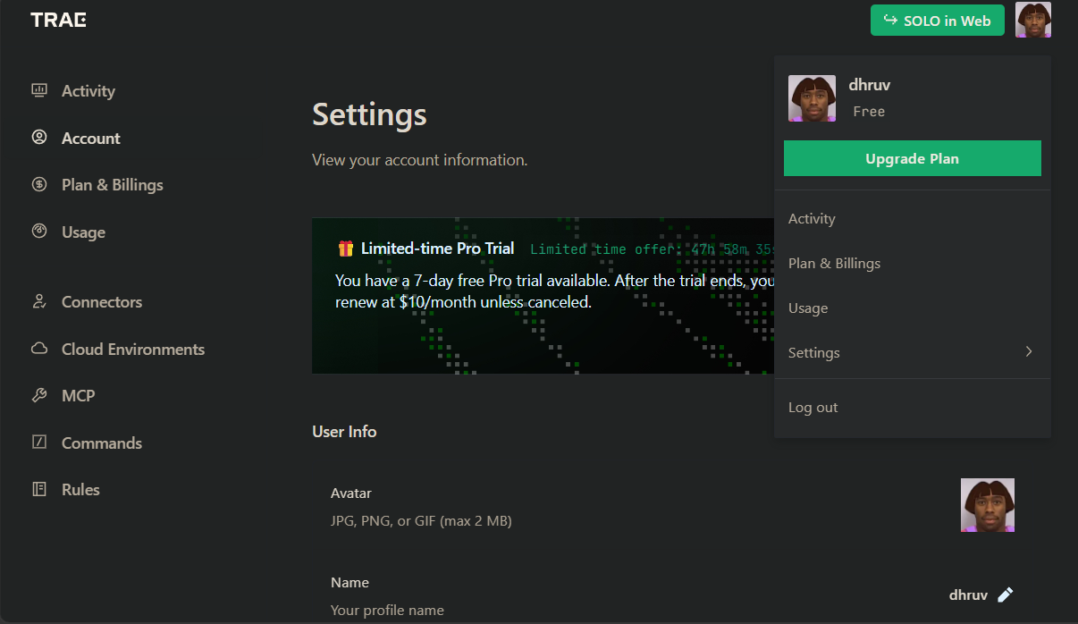
TRAE Account Upholding
Kanishka Pandey
Dhruv Makkar

Slide 8
you!
Thank

